Slide 1
CRYPTO 2023
International Cryptology Conference
GROUP 1

Slide 2

Opening Speech

Slide 3




235238 李婷婷
Opening speech
Han Yongxin
Identity authentication
Steve Smith
Blockchain
Yichu
System security
Notes:
Ladies and gentlemen,
Good [morning/afternoon/evening]. Welcome to our simulated academic conference on ”Crypto." In an era defined by interconnectedness, our focus on digital security is paramount.
Today, we‘ll explore innovative solutions and advancements in cybersecurity. From Identity authentication、Blockchain 、to System security，We invited three leading experts: Han Yongxin, Dean of the School of Computer Science and Technology at the University of California, and Steve Smith, Professor of the School of Cyberspace Security at the University of Tokyo, and Yichu, Principal Youth Professor of the School of Cyberspace Security at Southeast University.
, our discussions will shape the future of a secure digital world. I encourage active participation, idea exchange, and collaboration.

Slide 4

235238 李婷婷
Opening speech
Fortifying the foundations
Open minds
Building a more secure and resilient digital world.
Notes:
Let's collectively contribute to fortifying the foundations of our interconnected society. Thank you to our presenters and organizers for your dedication.
Together, let's embark on this intellectual journey with open minds and a shared commitment to building a more secure and resilient digital world.

Slide 5
Let the Conference Begin!
Notes:
Thank you, and let the conference begin.

Slide 6
Keynote

Slide 7



235234 侯宇捷
Keynote
Blockchain
Short Text Here
点击添加标题点击添加标题点击添加标题点击添加标题, 点击添加标题点击添加标题点击添加标题点击添加标题 点击添加标题点击添加标题点击添加标题点击添加标题nibh lacus laoreet turpis, quis
Identity authentication
System security

Slide 8

235234 侯宇捷
Blockchain
Security
Transparency
Decentralization
Short Text Here
点击添加标题点击添加标题点击添加标题点击添加标题, 点击添加标题点击添加标题点击添加标题点击添加标题 点击添加标题点击添加标题点击添加标题点击添加标题nibh lacus laoreet turpis, quis

Slide 9

235234 侯宇捷
Identity authentication
Necessary
Technological
Challenging
Short Text Here
点击添加标题点击添加标题点击添加标题点击添加标题, 点击添加标题点击添加标题点击添加标题点击添加标题 点击添加标题点击添加标题点击添加标题点击添加标题nibh lacus laoreet turpis, quis

Slide 10

235234 侯宇捷
System security
Data security
Consistency
Society trust
Short Text Here
点击添加标题点击添加标题点击添加标题点击添加标题, 点击添加标题点击添加标题点击添加标题点击添加标题 点击添加标题点击添加标题点击添加标题点击添加标题nibh lacus laoreet turpis, quis

Slide 11
Dynamic Trust-Based Redactable Blockchain Supporting Update and Traceability
Speaker：Steve Smith
University of Tokyo, Tokyo

Slide 12
PART 01
Introduction

Slide 13

235237 孙利峰
Introduction
Short Text Here
Immutability → Criminal Offenses
点击添加标题点击添加标题点击添加标题点击添加标题, 点击添加标题点击添加标题点击添加标题点击添加标题 点击添加标题点击添加标题点击添加标题点击添加标题nibh lacus laoreet turpis, quis
Blockchain
Prescription → Editable Blockchain

Slide 14
PART 02
Related work

Slide 15
235237 孙利峰
Related work
Short Text Here
rewritable blockchains based on chameleon hash
Re-chain: a rewritable blockchain with fixed storage
decentralized blockchain
点击添加标题点击添加标题点击添加标题点击添加标题, 点击添加标题点击添加标题点击添加标题点击添加标题 点击添加标题点击添加标题点击添加标题点击添加标题nibh lacus laoreet turpis, quis
Blockchain

Slide 16
PART 03
Contribution

Slide 17


235237 孙利峰
Contribution
Short Text Here
点击添加标题点击添加标题点击添加标题点击添加标题, 点击添加标题点击添加标题点击添加标题点击添加标题 点击添加标题点击添加标题点击添加标题点击添加标题nibh lacus laoreet turpis, quis
Supporting updates and traceability
pre-evaluation
modification permission restrictions
Traceability
Dynamic trust chameleon hash Blockchain

Slide 18
235237 孙利峰
Contribution
Short Text Here
点击添加标题点击添加标题点击添加标题点击添加标题, 点击添加标题点击添加标题点击添加标题点击添加标题 点击添加标题点击添加标题点击添加标题点击添加标题nibh lacus laoreet turpis, quis
Short time consumption
Features:
Trust is positively associated with the normal behavior
Malicious behavior can decrease trust greatly
Rewards decrease as trust increases
Consistent normal behavior is critical to trust.
Dynamic trust chameleon hash Blockchain

Slide 19
PART 04
Conclusion

Slide 20
235237 孙利峰
Conclusion
Pre-evaluating and controlling potential malicious users are effective.
pre-assessment
permission restriction
traceability
We hope our work will inspire more interested people to get involved!
Short Text Here
点击添加标题点击添加标题点击添加标题点击添加标题, 点击添加标题点击添加标题点击添加标题点击添加标题 点击添加标题点击添加标题点击添加标题点击添加标题nibh lacus laoreet turpis, quis

Slide 21
235232 陈巍炜
Q&A SLF
Short Text Here
点击添加标题点击添加标题点击添加标题点击添加标题, 点击添加标题点击添加标题点击添加标题点击添加标题 点击添加标题点击添加标题点击添加标题点击添加标题nibh lacus laoreet turpis, quis
Q：
What are the advantages of dynamic blockchain over traditional blockchain？

Slide 22
Quantum2FA:
Efficient Quantum-Resistant Two-Factor Authentication Scheme for Mobile Devices
Speaker：Han Yongxin
University of California, Los Angeles

Slide 23
PART 01
Introduction

Slide 24
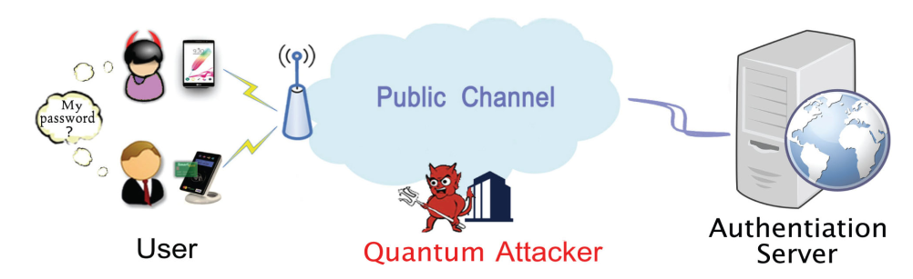
235236 韩永欣
Introduction
Smart-card based password authentication:
Two-factor authentication (2FA) mechanism for security
Built on the difficulty of conventional hard problems
no longer hard in the quantum era
Short Text Here
点击添加标题点击添加标题点击添加标题点击添加标题, 点击添加标题点击添加标题点击添加标题点击添加标题 点击添加标题点击添加标题点击添加标题点击添加标题nibh lacus laoreet turpis, quis
Quantum2FA —— a practical quantum-resistant smart-card-based password authentication scheme

Slide 25
PART 02
Evaluation Framework

Slide 26
235236 韩永欣
Evaluation Framework
2 important criteria:
Quantum security
Efficiency
Evaluation framework for 2FA under conventional computers
12 evaluation criteria
Capabilities of the adversary
Attacks
Quantum attacks
Extend the traditional attacks to the quantum setting
Short Text Here
点击添加标题点击添加标题点击添加标题点击添加标题, 点击添加标题点击添加标题点击添加标题点击添加标题 点击添加标题点击添加标题点击添加标题点击添加标题nibh lacus laoreet turpis, quis
comprehensive

Slide 27
PART 03
Contribution

Slide 28
235236 韩永欣
Contribution
Short Text Here
Quantum2FA
4 parts:
Registration
Log-in
Verification
Password-changing
Security based on the Ring-LWE problem
Formal security analysis:
Secure against attacks from both classical and quantum computers
Implementation:
More secure
Offers better computation efficiency
点击添加标题点击添加标题点击添加标题点击添加标题, 点击添加标题点击添加标题点击添加标题点击添加标题 点击添加标题点击添加标题点击添加标题点击添加标题nibh lacus laoreet turpis, quis

Slide 29
PART 04
Conclusion

Slide 30
235236 韩永欣
Conclusion
Quantum2FA
A secure and efficient smart-card-based password authentication scheme for the mobile devices
The first 2FA scheme that is secure against attacks from both quantum and conventional computers
Hope we will spark interest for new quantum-resistant 2FA research!
Short Text Here
点击添加标题点击添加标题点击添加标题点击添加标题, 点击添加标题点击添加标题点击添加标题点击添加标题 点击添加标题点击添加标题点击添加标题点击添加标题nibh lacus laoreet turpis, quis

Slide 31

Thanks for attention!
Q&A

Slide 32
235232 陈巍炜
Q&A HYX
Q：
Why RLWE was chosen as security for the algorithm?
Short Text Here
点击添加标题点击添加标题点击添加标题点击添加标题, 点击添加标题点击添加标题点击添加标题点击添加标题 点击添加标题点击添加标题点击添加标题点击添加标题nibh lacus laoreet turpis, quis

Slide 33
DRoT:
A Decentralised
Root of Trust for Trusted Networks
Speaker：Yichu

Slide 34
PART 01
Introduction

Slide 35

235235 窦艺初
network attestation mechanism
Create a root of trust for network attestation
Notes:
For many years, trusted computing research has focused on the trustworthiness of single computer platforms. To check on the trustworthiness of a network, we need a network attestation mechanism. The basis of attestation is a root of trust, and research on building roots of trust for individual devices has been successful. One of the next challenges, the most important one, is to create a root of trust for network attestation.

Slide 36
PART 02
Contributions

Slide 37
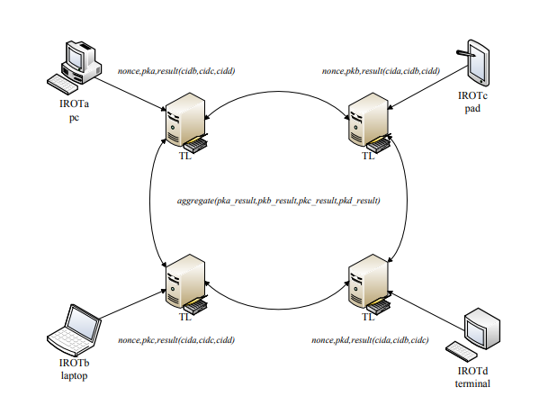
235235 窦艺初
Trust or not
Notes:
Our proposed design is for a network root of trust used for measurement and storage for the network. The measurement and storage components of our network root of trust work together to aggregate measurements from individual devices and store them securely. Once these results are verified they provide evidence on the state of the devices on the network which can then be used to decide whether the can be trusted.
In our design, data and execution code，which in the form of smart contracts，are managed by a distributed ledger. This ensures that the system is tamper-proof and this then forms a decentralised root of trust (DRoT) for the network.

Slide 38
PART 03
Improvement

Slide 39

235235 窦艺初
report
assessment results
anomaly detection reports
Notes:
Our work does not implement a reporting function, but subsequent enhancements could include adding assessment results and anomaly detection reports to the ledger, which would provide additional evidence of the network's status and enhance the transparency and credibility of the entire system

Slide 40
PART 04
Summary

Slide 41
235235 窦艺初
We have described a DRoT for networks.
A distributed ledger is used to provide tamper proof storage for the attestation evidence for individual devices on the network together with the attestation results from verifiers.
We have implemented it using docker containers
Notes:
containers – these make it easy for the system to be tested and explored by other interested researchers.

Slide 42
Q&A
Feel Free to ask anything！

Slide 43
235232 陈巍炜
Q&A DYC
Short Text Here
点击添加标题点击添加标题点击添加标题点击添加标题, 点击添加标题点击添加标题点击添加标题点击添加标题 点击添加标题点击添加标题点击添加标题点击添加标题nibh lacus laoreet turpis, quis
Q：
What is the purpose of the D in DRoT?

Slide 44
Conclusion

Slide 45
235233 金子昂
Identity authentication
Han：Quantum2FA: Efficient Quantum-Resistant Two-Factor Authentication Scheme for Mobile Devices
Blockchain
Sun：Dynamic Trust-Based Redactable Blockchain Supporting Update and Traceability
System security
Dou：DRoT: A Decentralised Root of Trust for Trusted Networks
Notes:
Thans for your listening. And finally let me give you a brief summary of the CRYPT 23. We have three main themes in our conference, which are Identity authentication, blockchain and system security. For the part of identity authentication, Miss Han give us a wonderful speech of Quantum2FA , an efficient and practical quantum-based method of 2 factore authentication. While Mr sun give us a speech about the blockchain. He introduced a scheme of blockchain that is trust-based and able to be updated and traced. For the last section, Miss Dou proposed aD novel ecentralised Root of Trust for Trusted Networks called Drot. And that’s all of our conference, thx you.

Slide 46
THANKS
汇报人：Group1

